Slide 1
Lesson 1 - Gitlab + Intellij IDEA

Slide 2
Homework
Download, install and setup required software
Create GitLab account
Fork course repository
Configure checkstyle plugin for IDEA
Add support of “.gitignore” in project
Make a first commit/push
(optional) Take a screenshot of homework result
Create a Gitlab Issue with attached screenshot and assign to a lector

Slide 3
Required Software to Download and Install
Git -> https://git-scm.com/downloads
JDK -> https://www.oracle.com/java/technologies/javase-jdk15-downloads.html
Intellij IDEA Community Edition -> https://www.jetbrains.com/toolbox-app/

Slide 4
Register on Gitlab.com
Go to https://gitlab.com
Register using your Full Name (ex. Vasya Rudas)
Go to https://gitlab.com/profile
Upload your photo (same as for slack) as avatar

Slide 5
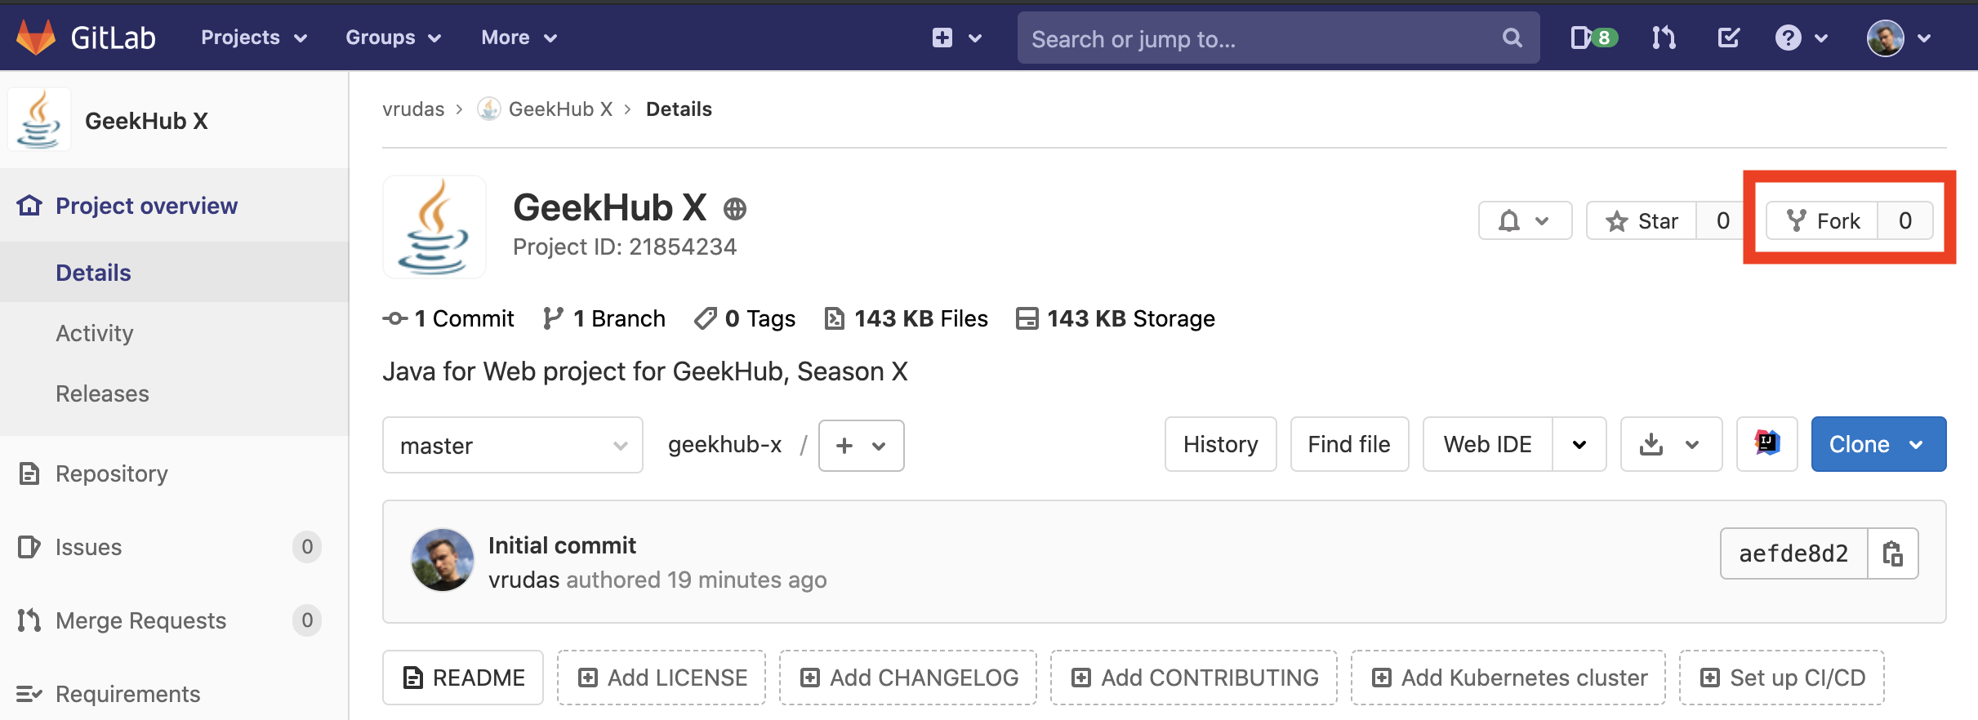
Fork GeekHub X repository
Login to https://gitlab.com
Go to https://gitlab.com/vrudas/geekhub-x
Click “Fork “ button
Select your user as namespace to fork the project

Slide 6
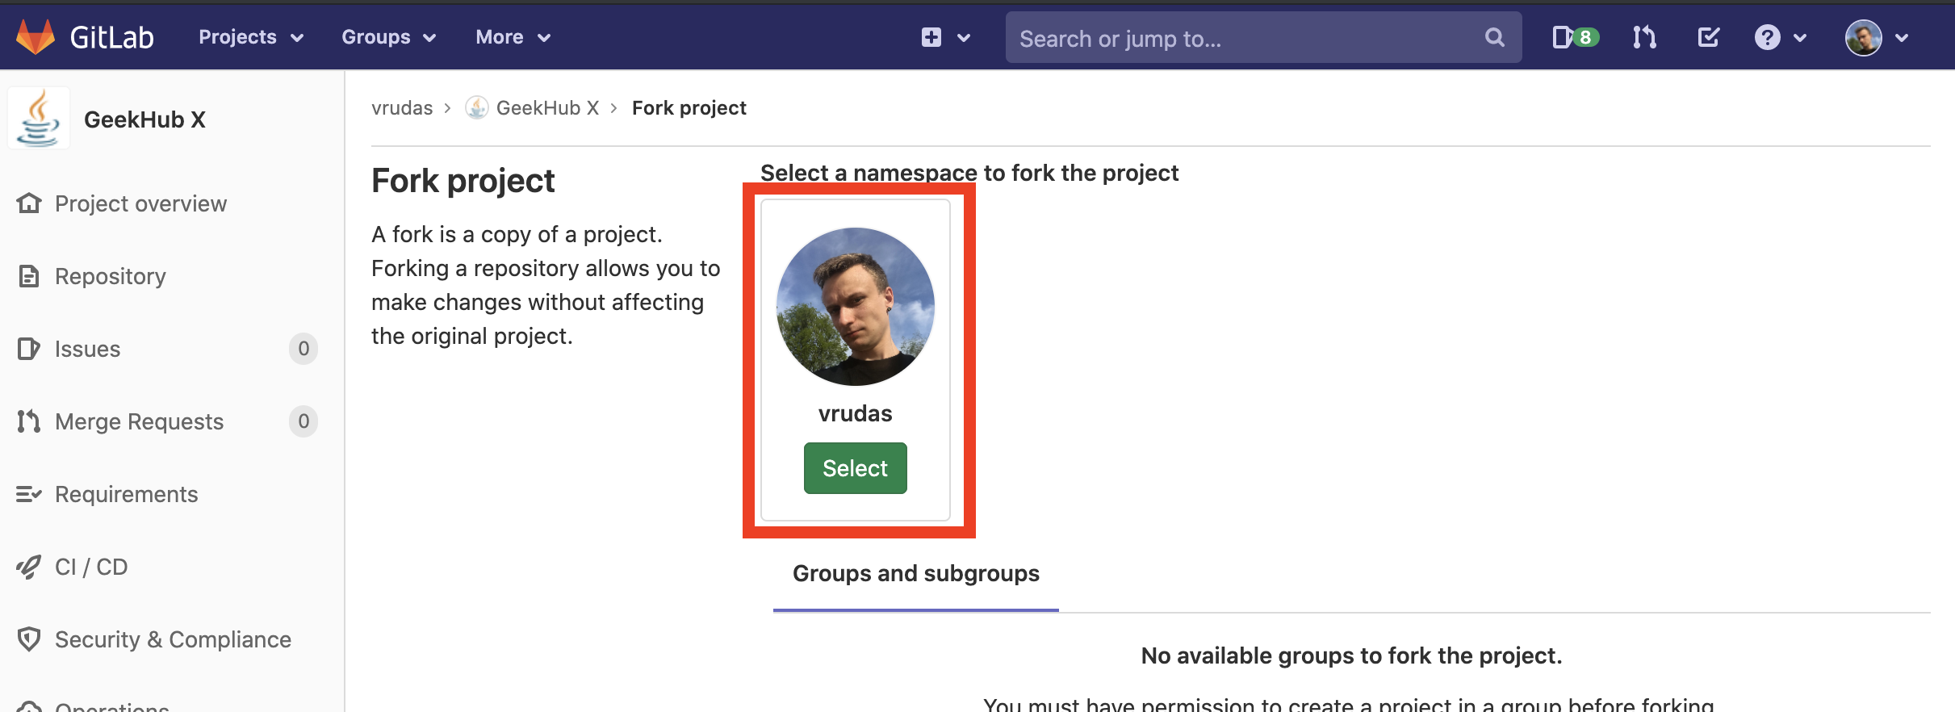
Fork GeekHub X repository

Slide 7
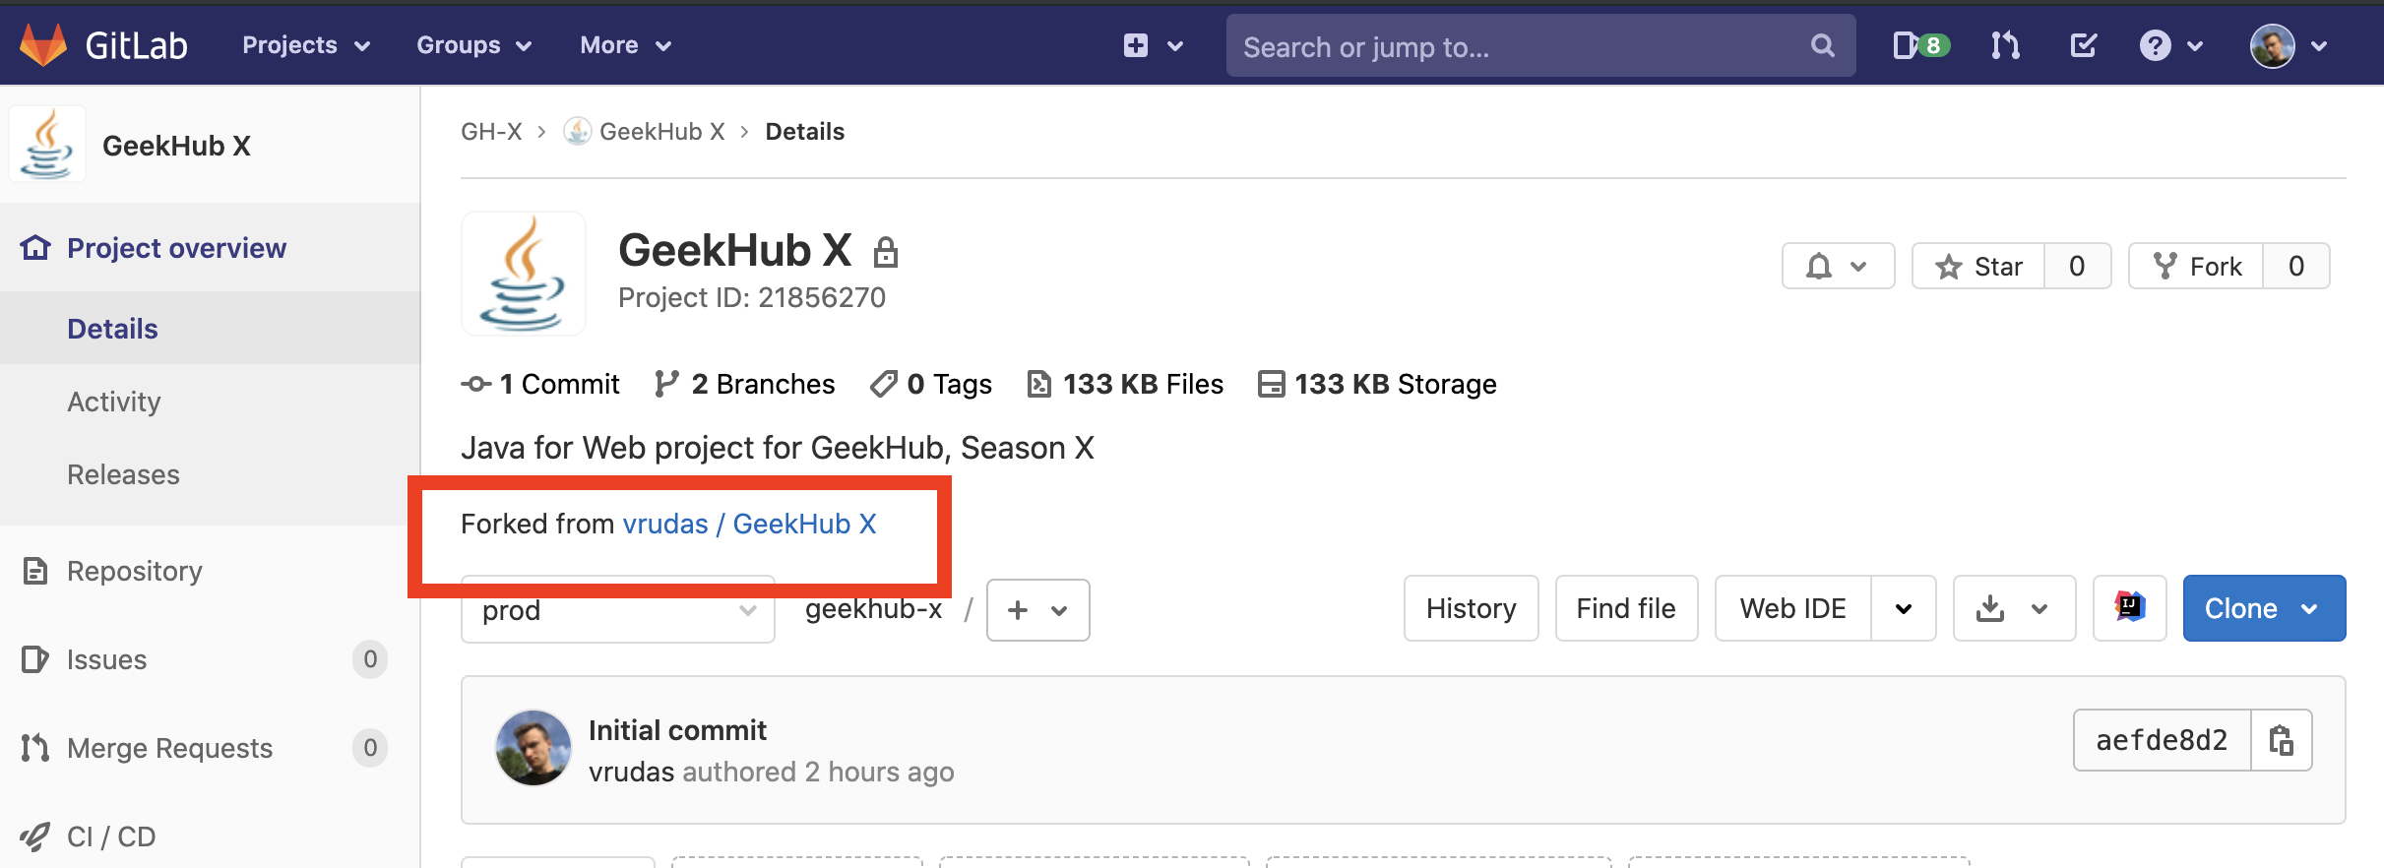
Fork GeekHub X repository

Slide 8
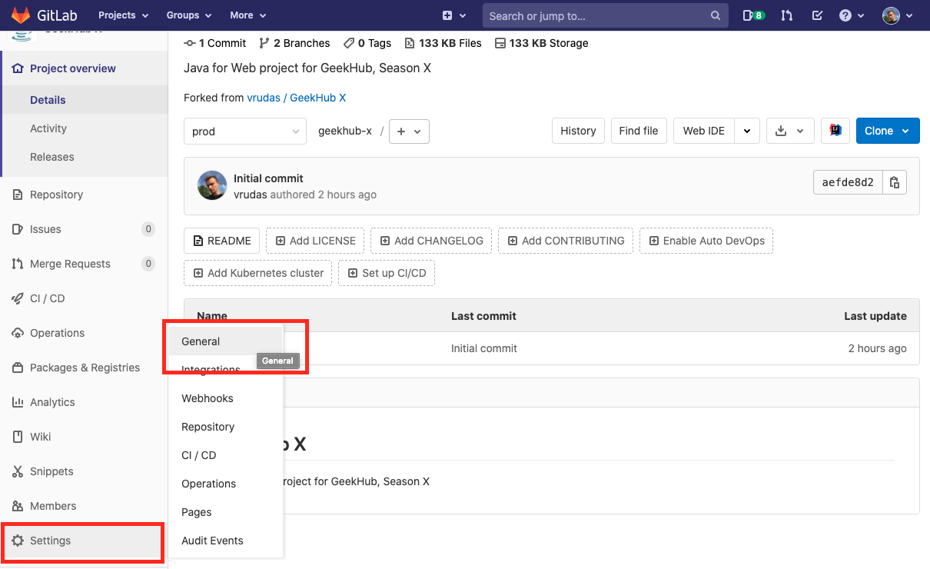
Fork GeekHub X repository
Click “Setting” -> “General” on the opened page in sidebar menu

Slide 9
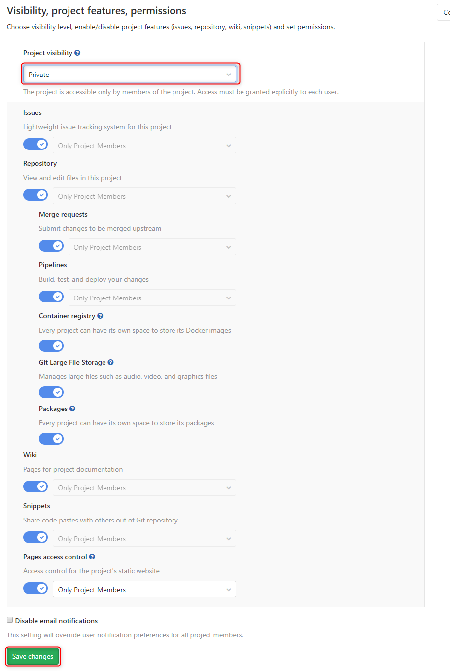
Fork GeekHub X repository
Expand “Permissions” section
Change “Project visibility” to “Private”
Click “Save changes” button

Slide 10
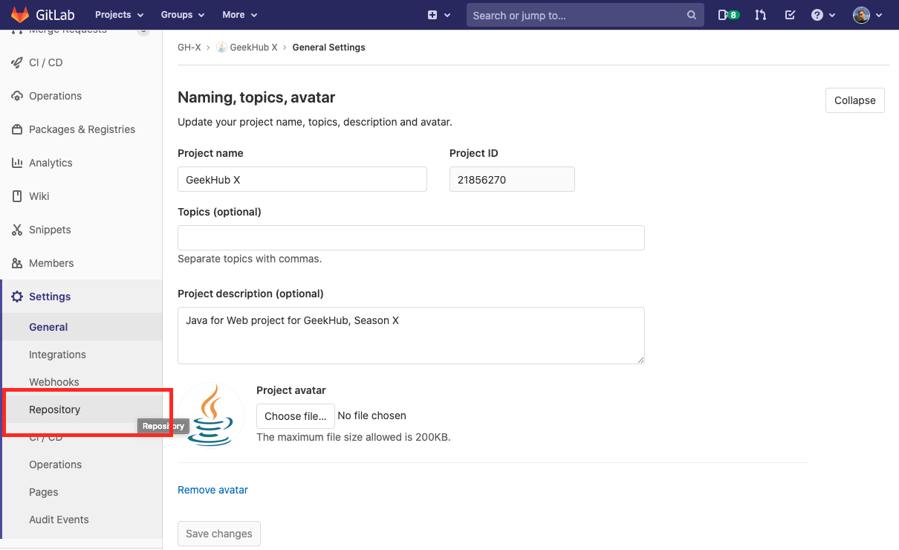
Fork GeekHub X repository
Click “Setting” -> “Repository” in sidebar menu

Slide 11
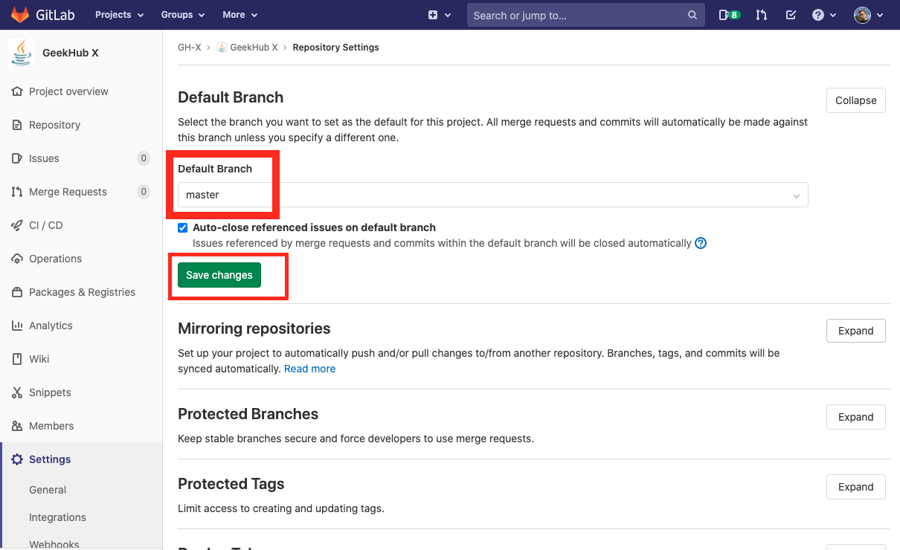
Fork GeekHub X repository
Expand “Default Branch” section
Verify that “master” is selected as a default branch in your repository

Slide 12
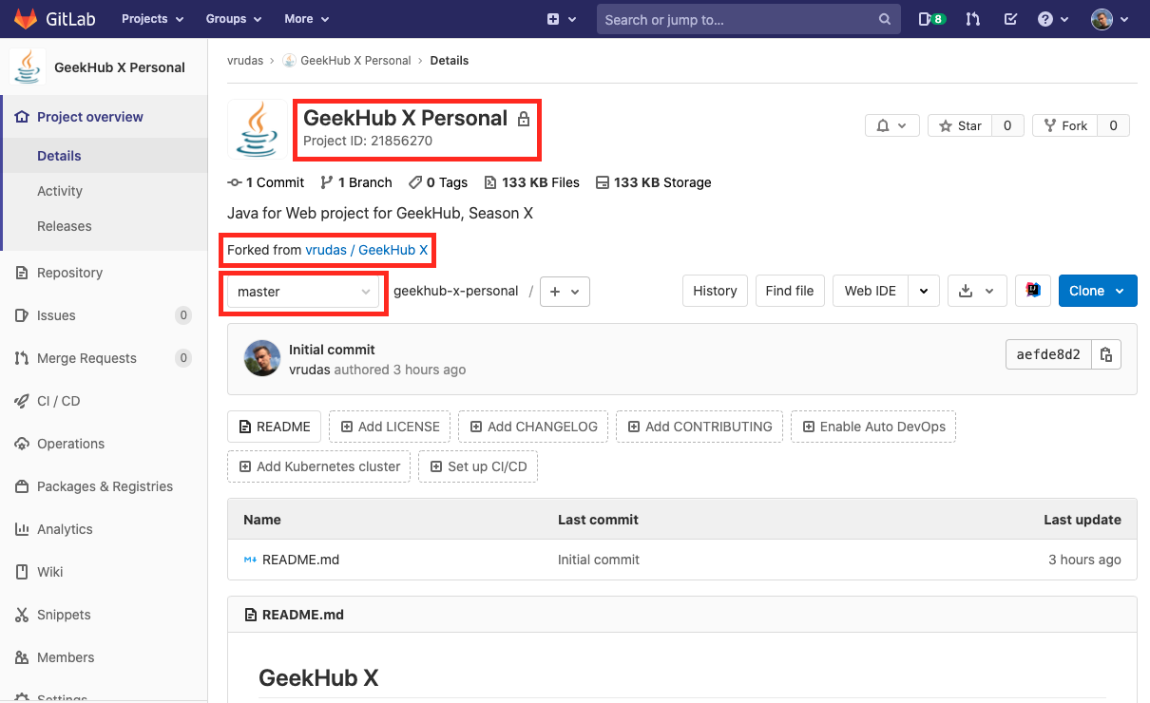
Fork GeekHub X repository
Click “Project” -> “Details” in sidebar menu
Verify that all options in your repository are the same as on the screenshot

Slide 13
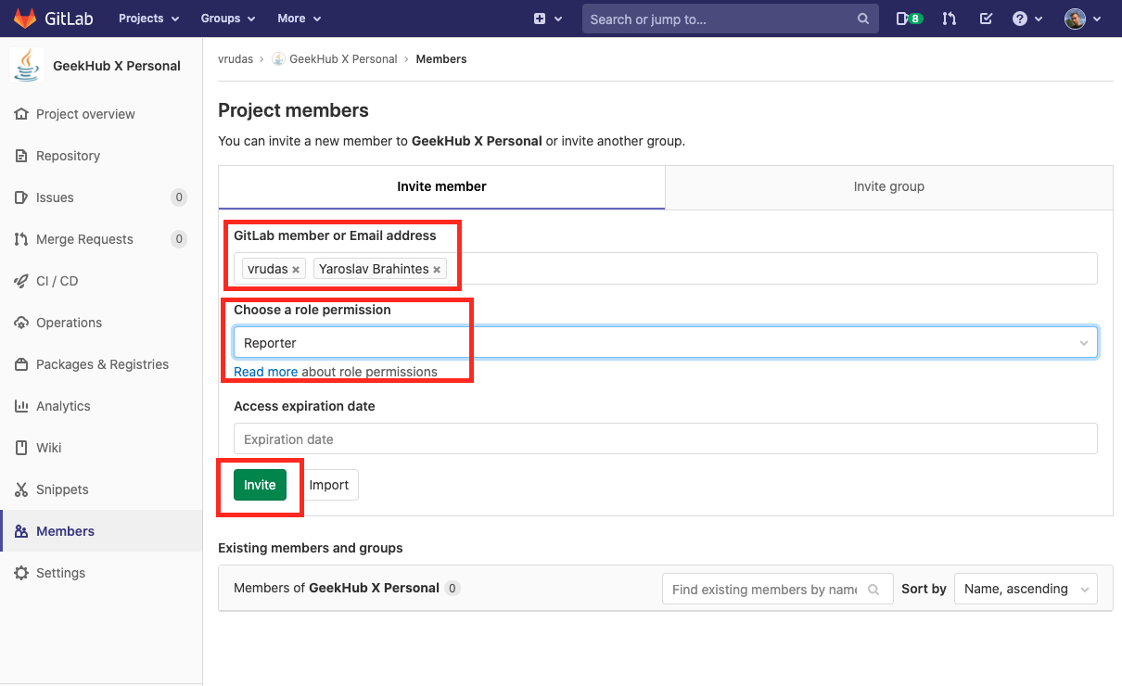
Fork GeekHub X repository
Click “Settings” -> “Members” in sidebar menu
Add y.brahinets, vrudas as Reporter
Click “Add to project”

Slide 14
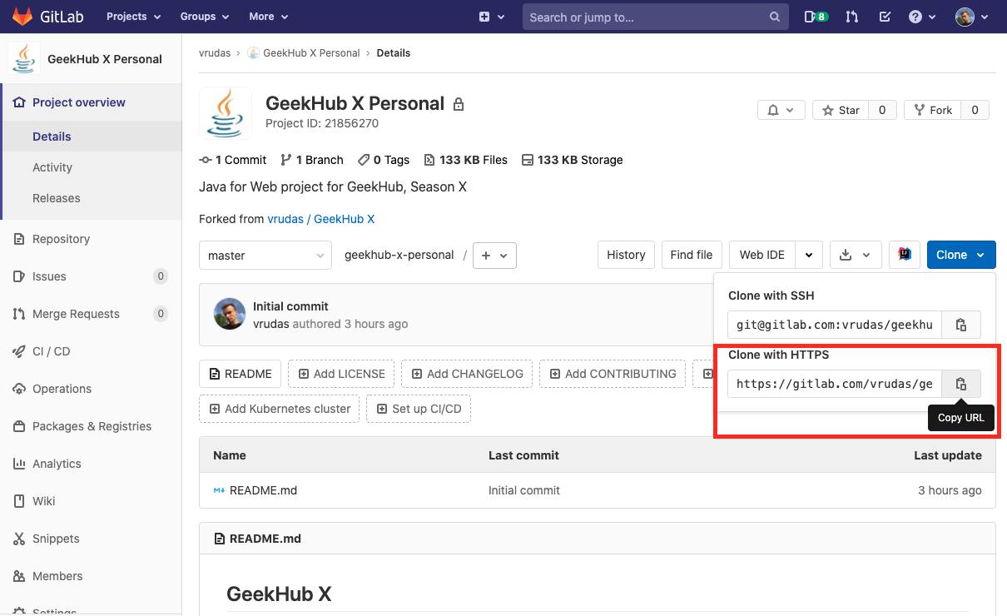
Import project into IDEA
Click “Project” -> “Details” in sidebar menu
Choose HTTPS type of link
Copy link to your repository

Slide 15
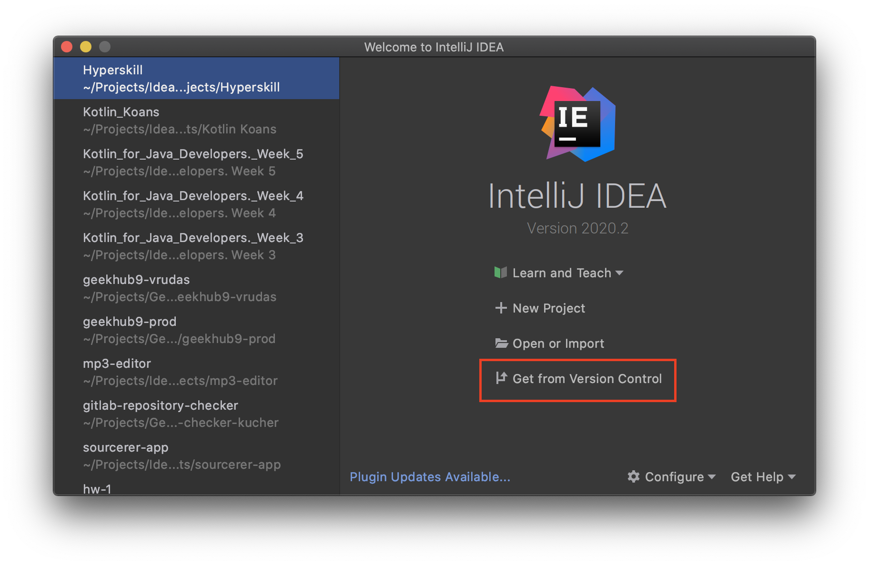
Import project into IDEA
Open Intellij IDEA
Choose “Get from Version Control”
Choose “Git”

Slide 16
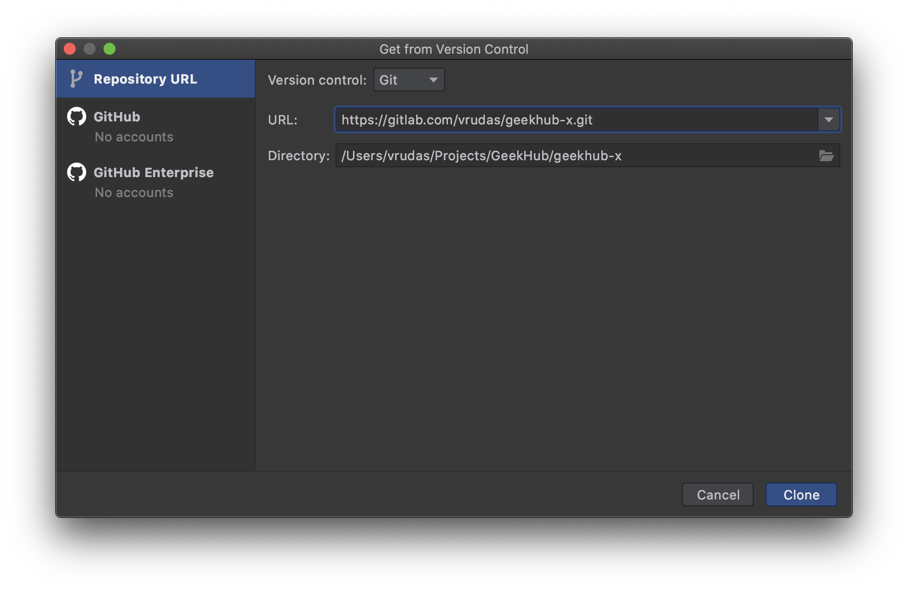
Import project into IDEA
Paste copied link of repository into just opened window
Click “Clone”

Slide 17
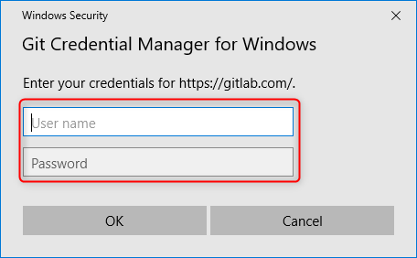
Import project into IDEA
Input your login and password for Gitlab.com if required

Slide 18
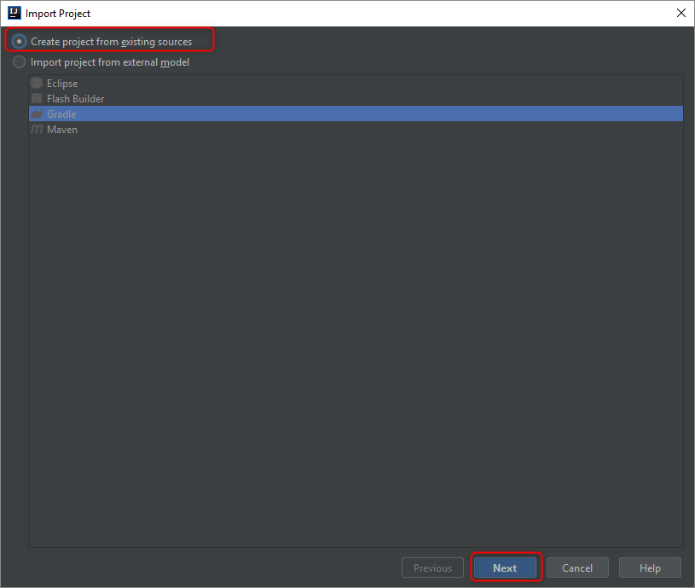
Import project into IDEA
Choose “Create project from existing source”
Click “Next”

Slide 19
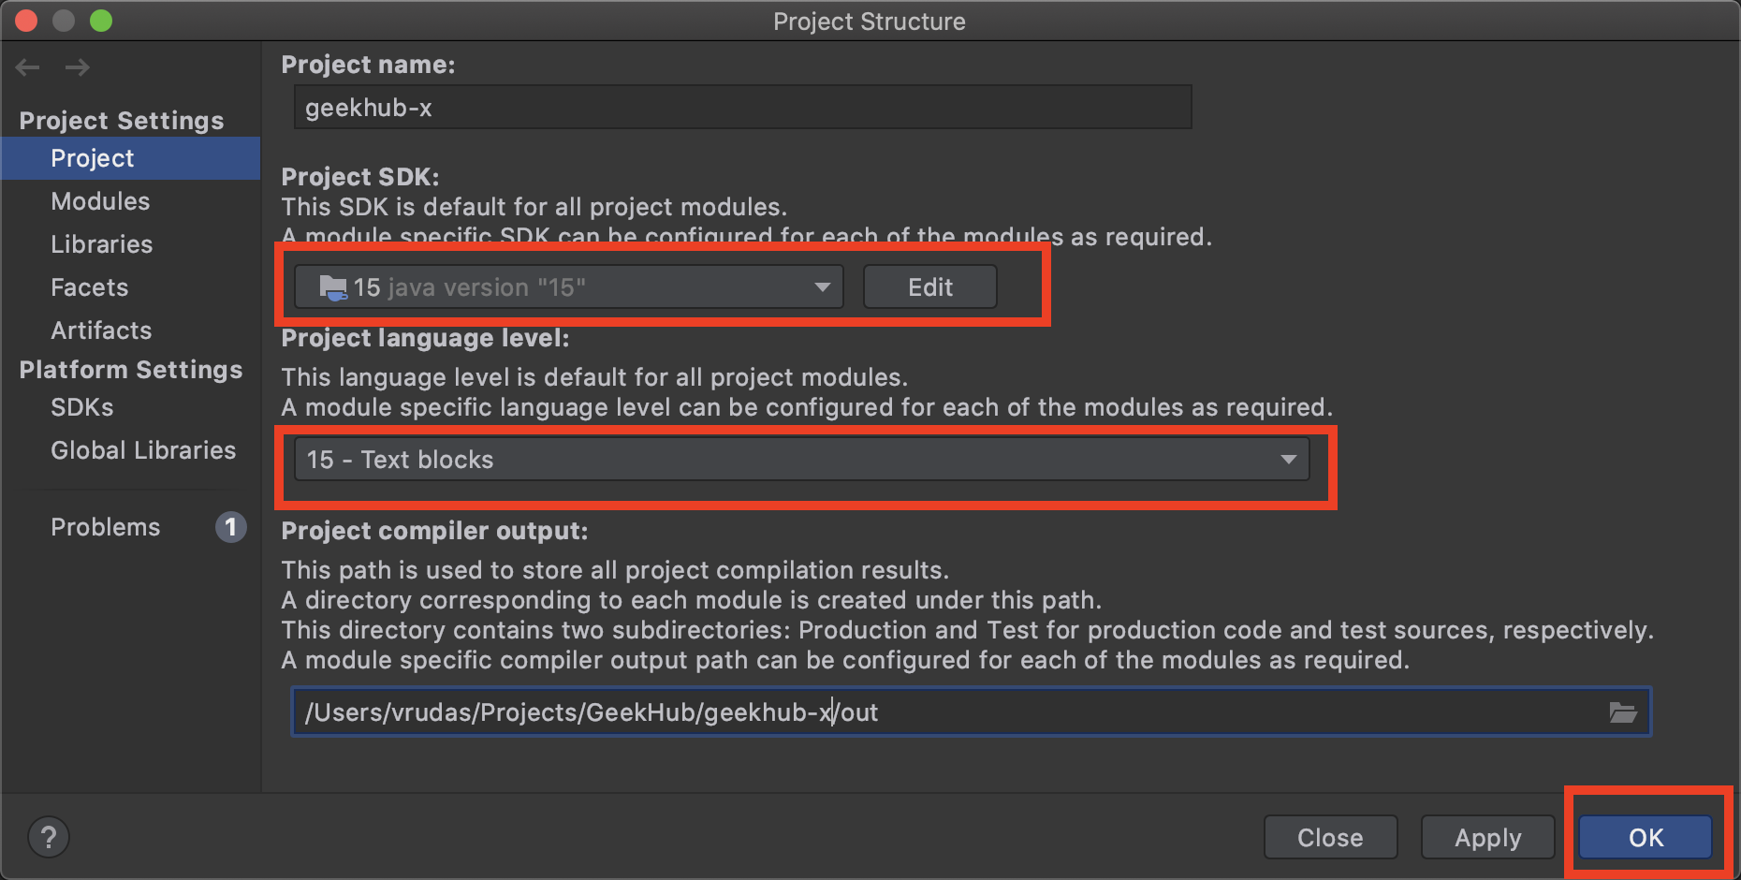
Import project into IDEA
Choose your project and press “Ctrl+Enter”
Choose “Project” tab
Add new JDK for IDEA by clicking “Edit” button, if required
Choose JDK 15 for your project
Choose “Project language level”: 15 – Text blocks…
Click “OK”

Slide 20
CheckStyle plugin

Slide 21
Setup CheckStyle Plugin for IDEA
How to install plugin in Intellij IDEA -> https://www.jetbrains.com/help/idea/managing-plugins.html
Install required CheckStyle plugin:
https://plugins.jetbrains.com/plugin/1065-checkstyle-idea

Slide 22
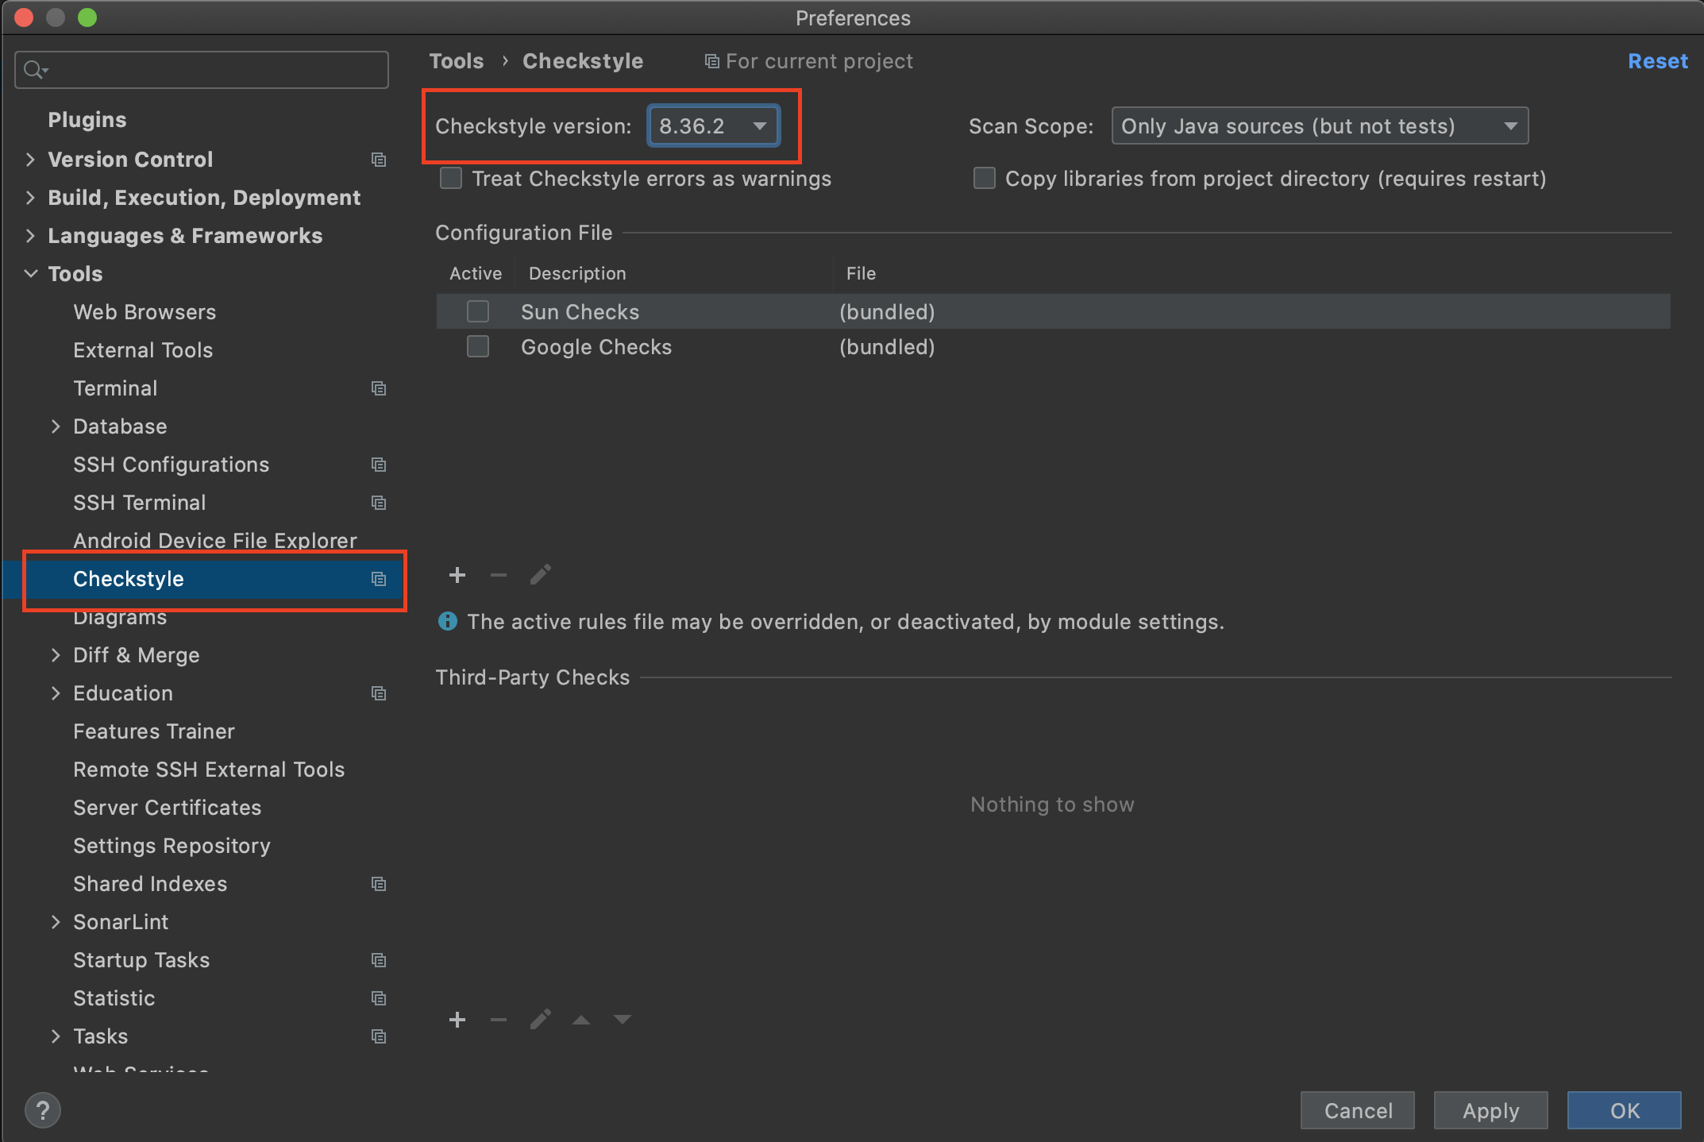
Setup CheckStyle Plugin for IDEA
Go to IDEA Preferences (Ctrl + Alt + S)
Find CheckStyle settings
Set CheckStyle version “8.36.2” (important)

Slide 23
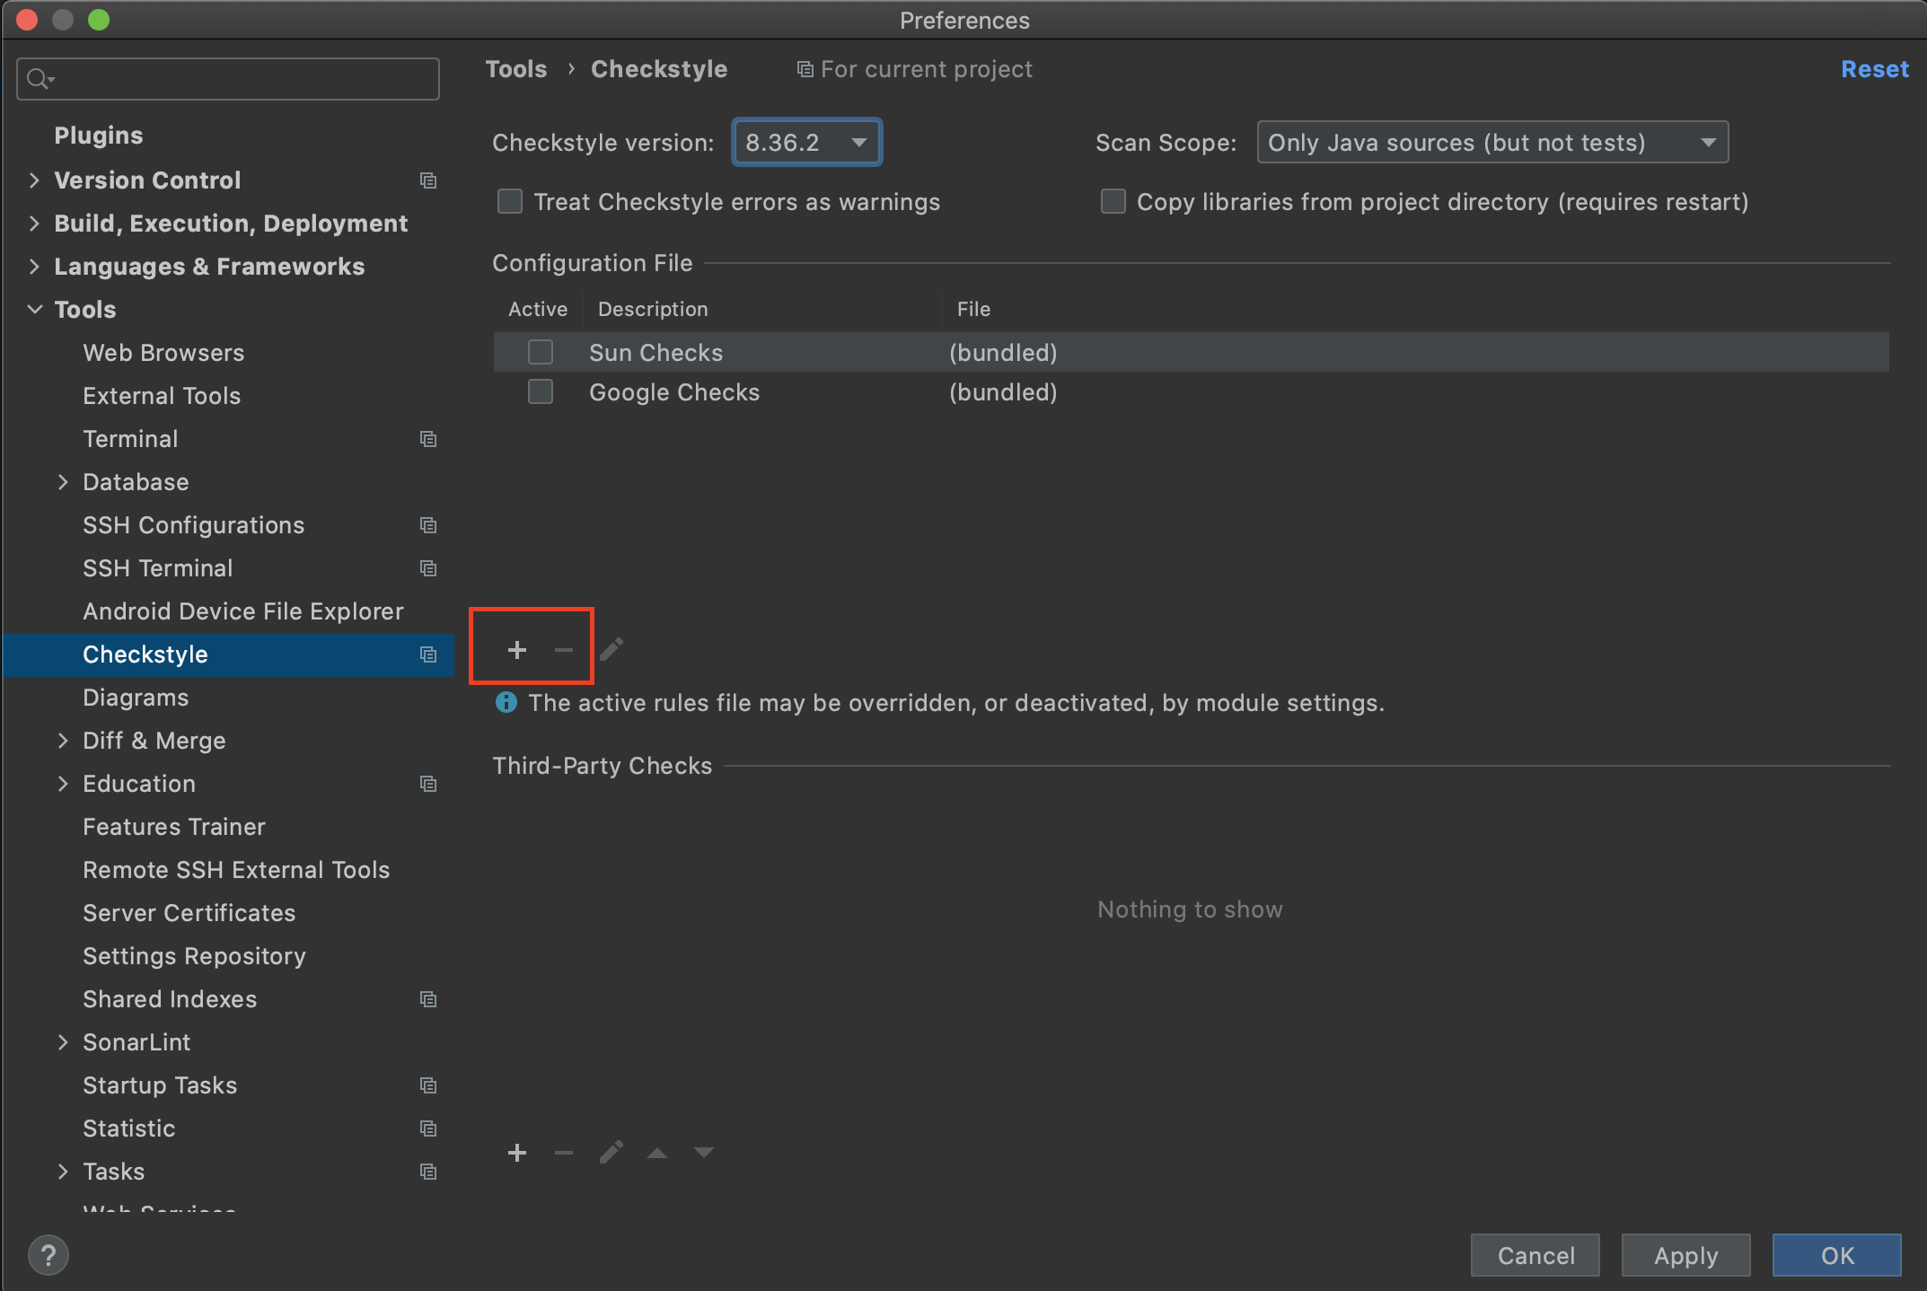
Setup CheckStyle Plugin for IDEA
Add custom checkstyle rules(/config/checkstyle/checkstyle.xml)

Slide 24
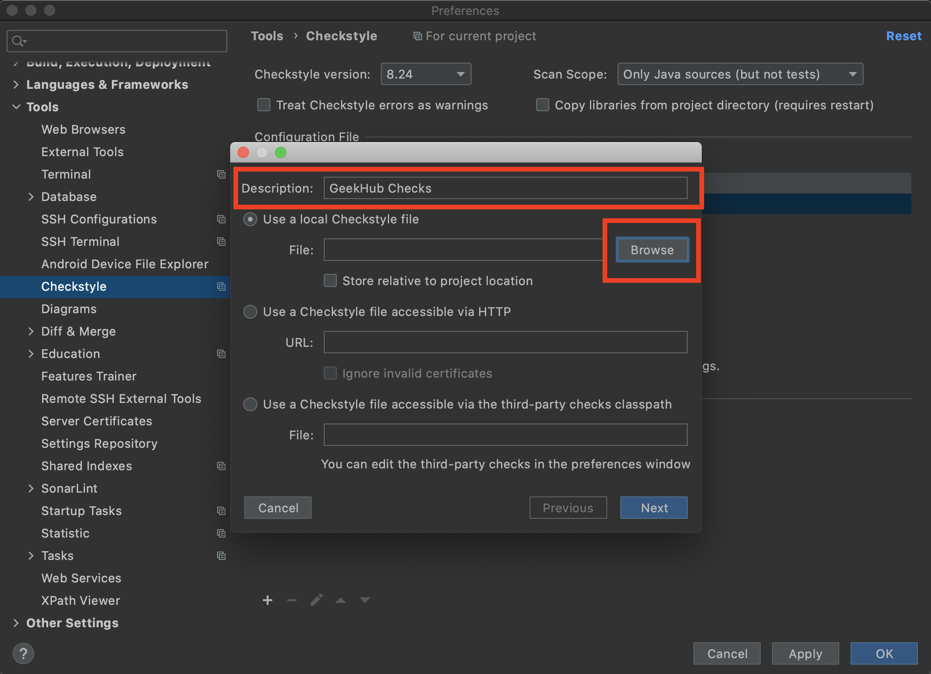
Setup CheckStyle Plugin for IDEA
Add custom checkstyle rules(/config/checkstyle/checkstyle.xml)

Slide 25
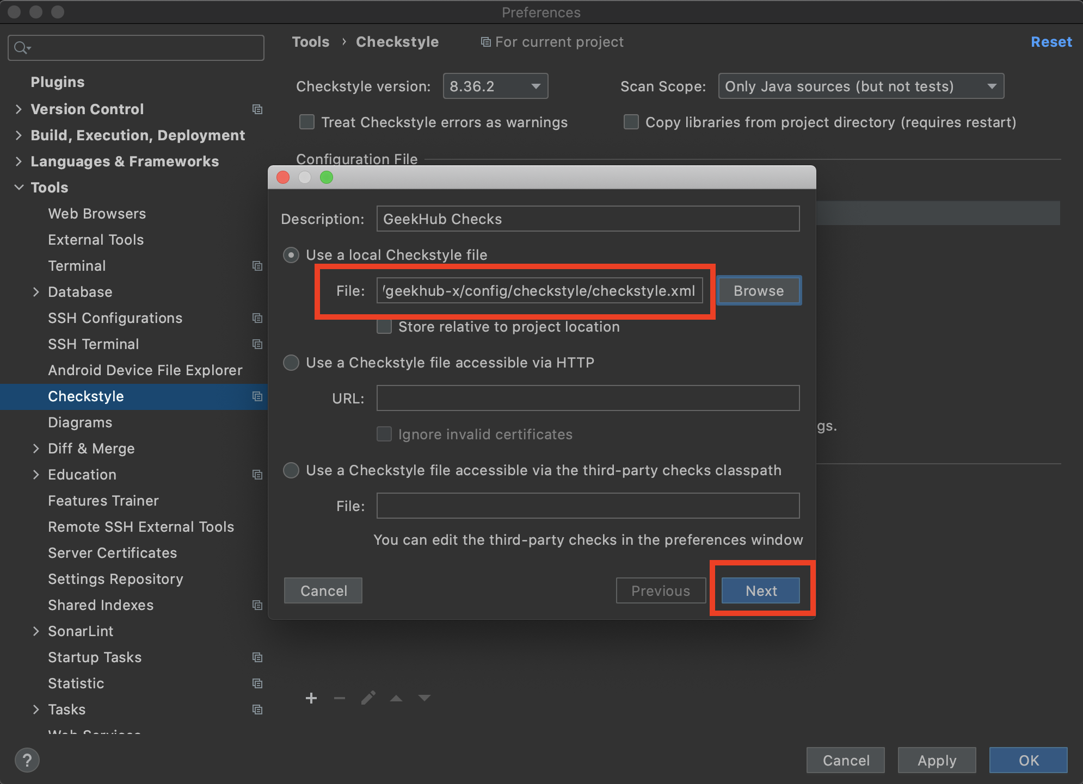
Setup CheckStyle Plugin for IDEA
Add custom checkstyle rules(/config/checkstyle/checkstyle.xml)

Slide 26
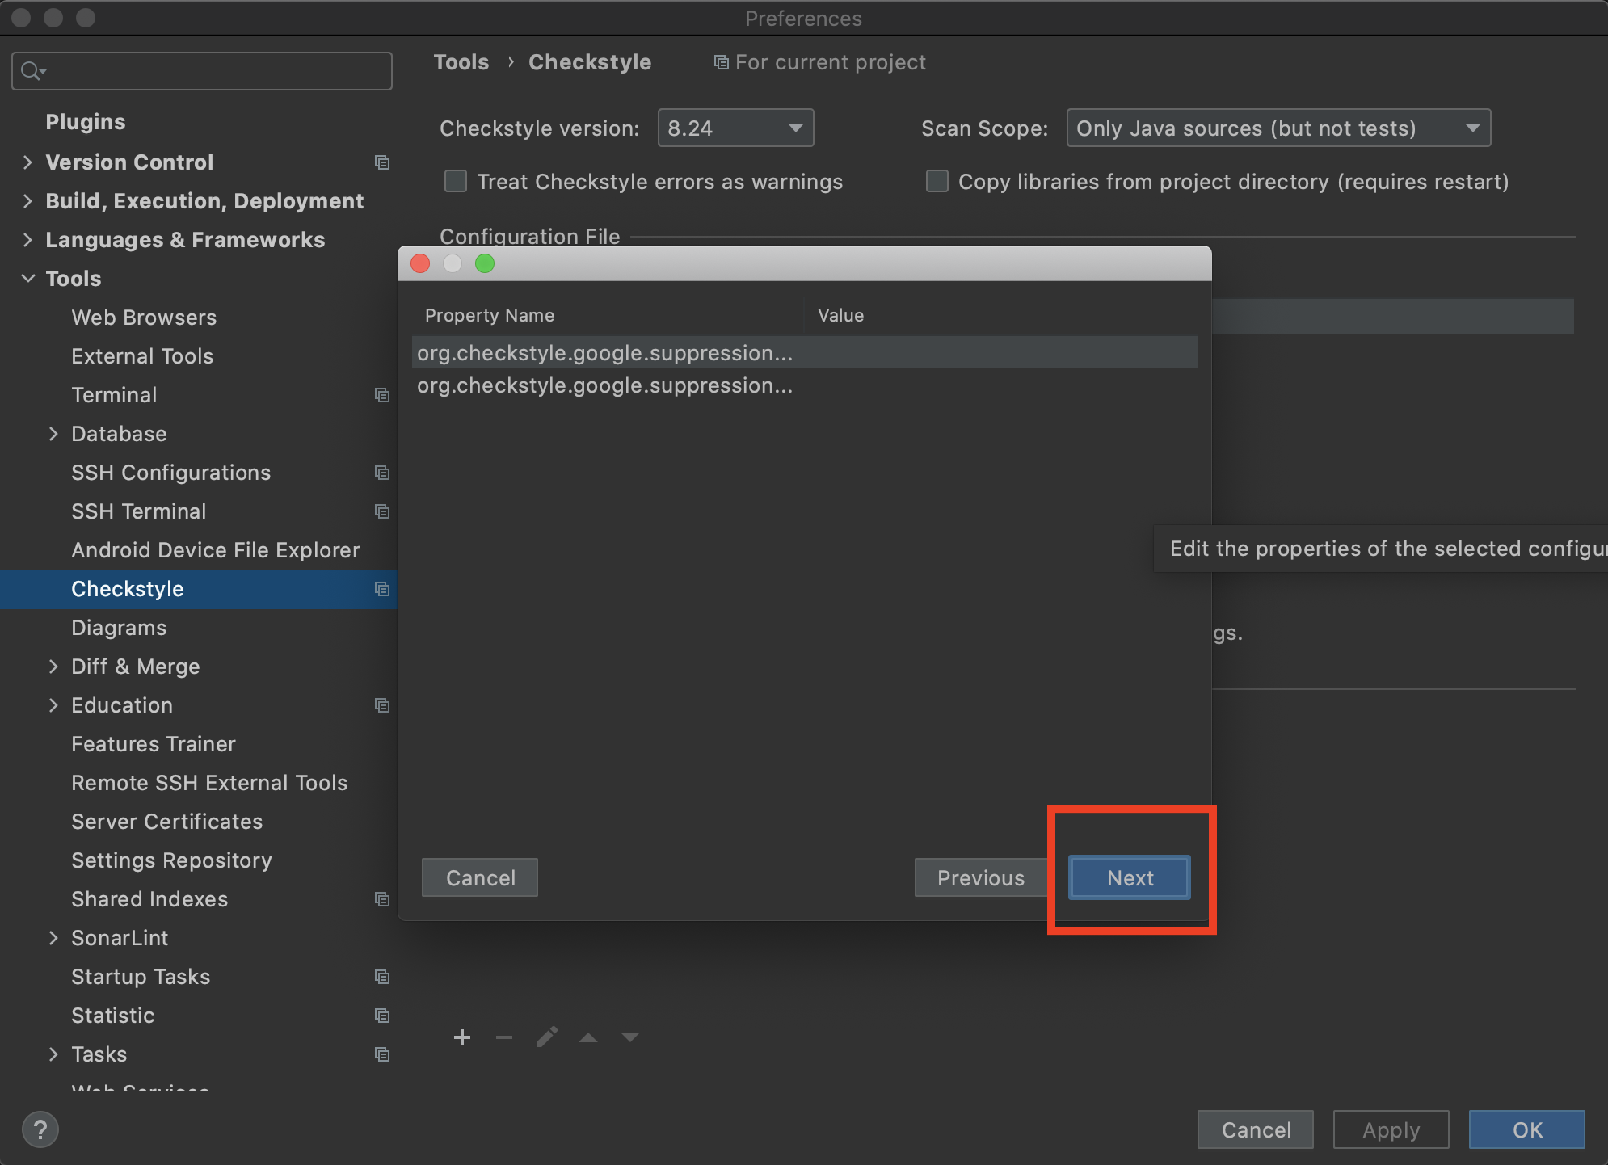
Setup CheckStyle Plugin for IDEA
Add custom checkstyle rules(/config/checkstyle/checkstyle.xml)

Slide 27
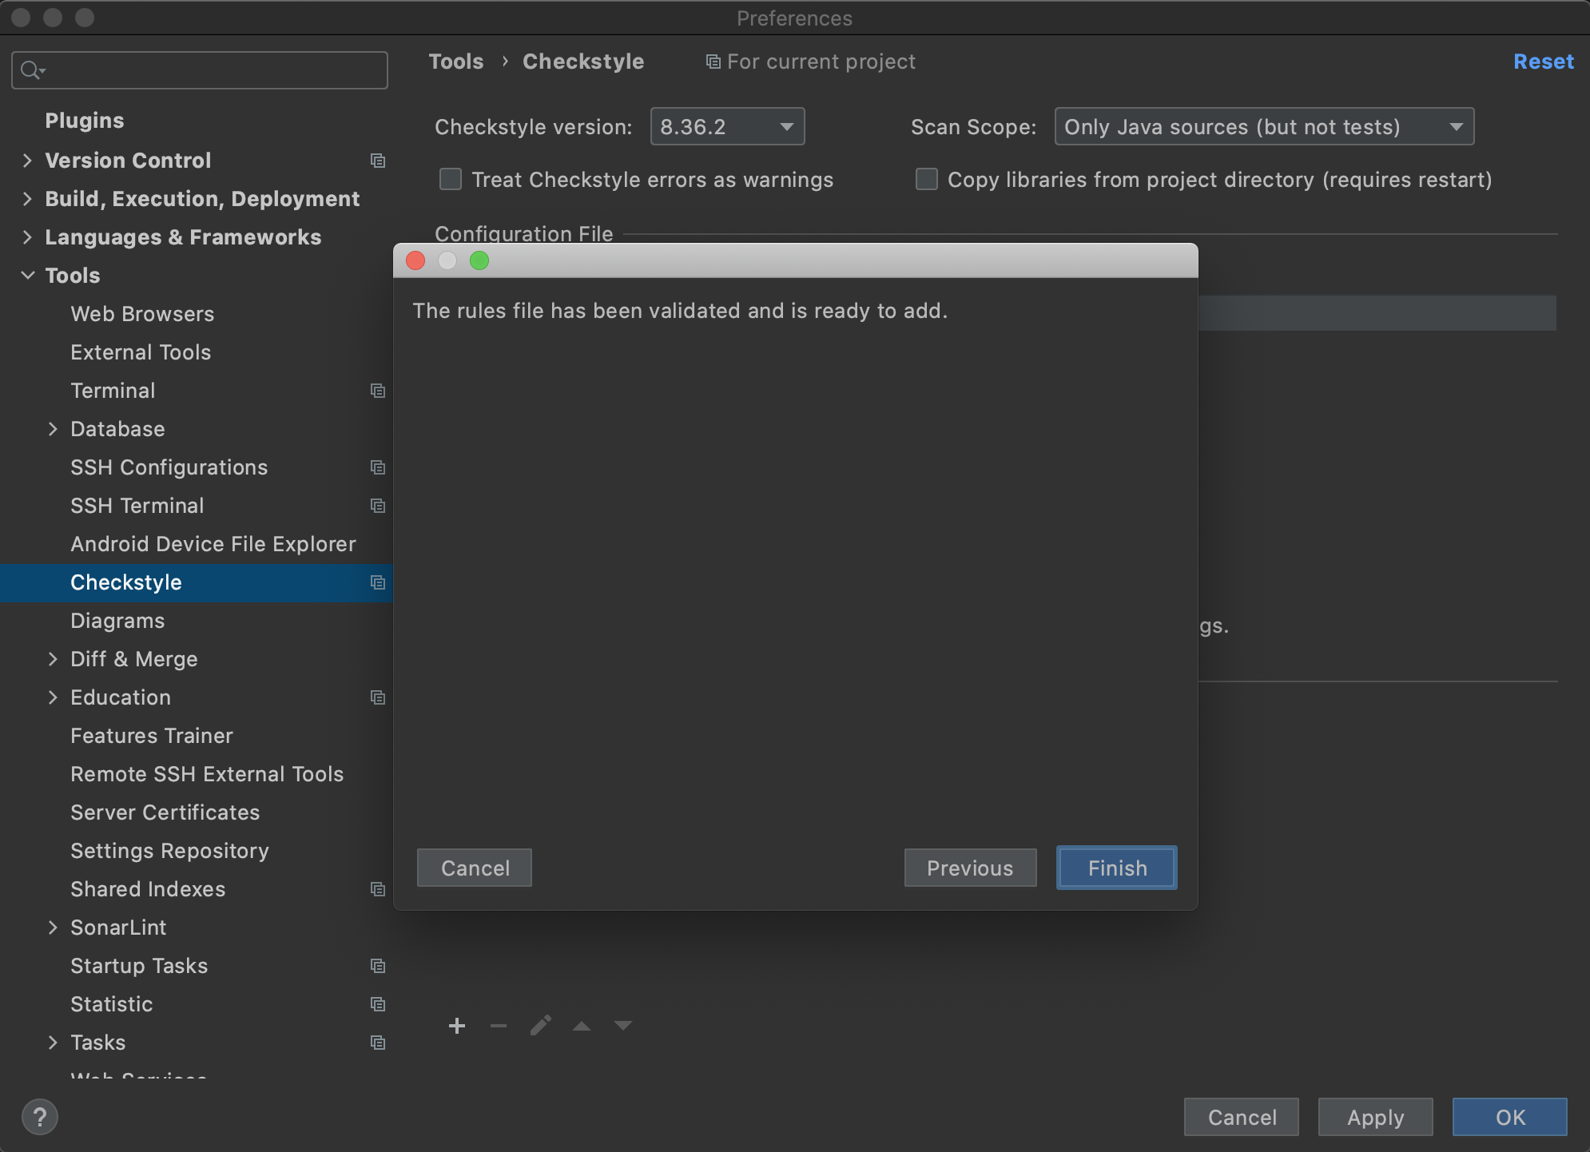
Setup CheckStyle Plugin for IDEA
Add custom checkstyle rules(/config/checkstyle/checkstyle.xml)

Slide 28
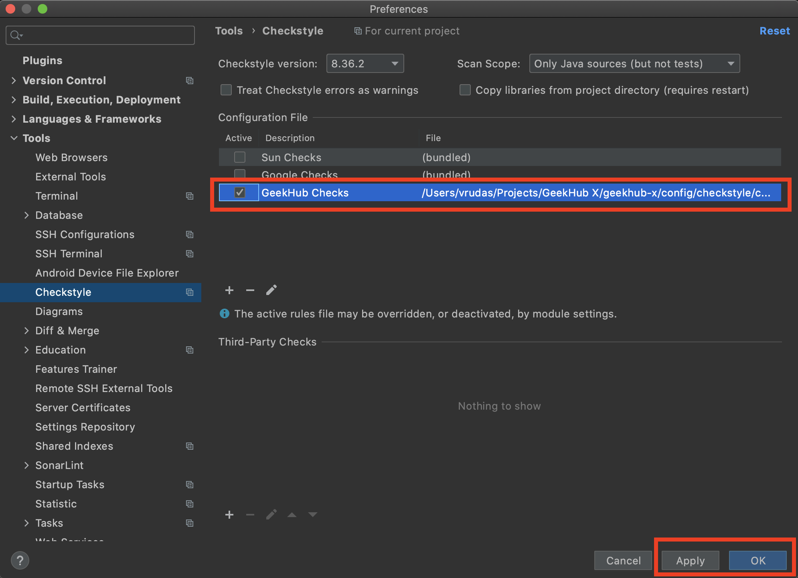
Setup CheckStyle Plugin for IDEA
Set a “GeekHub Checks” as a default for project

Slide 29
.gitignore and first commit !

Slide 30
Create .gitignore file
Read info about .gitignore
Create .gitignore file in a root of project folder
Add those lines:
.idea *.iml out/ build/ classes/ .gradle /libs/

Slide 31
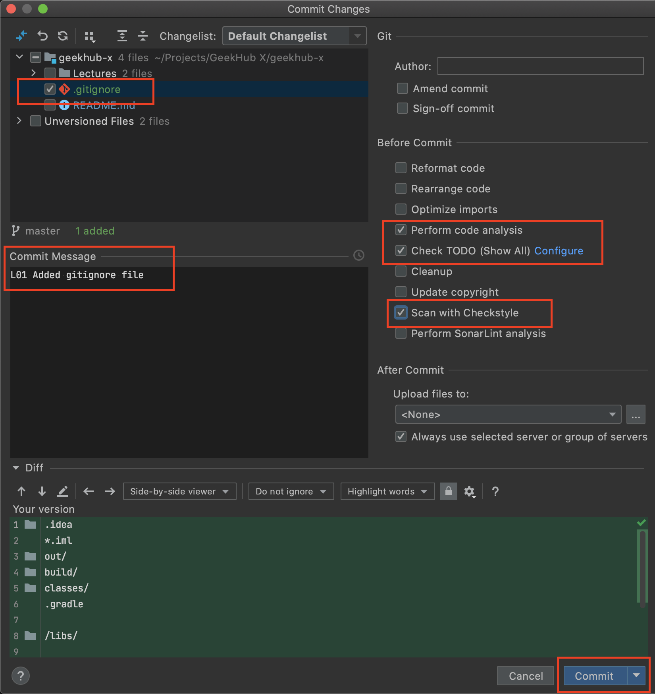
First Commit and Push to Git
You have made some changes, it’s time to commit and push
Press “Ctrl+K” to make commit
Choose files that should be committed
Type understandable and informative “L## Commit Message”
Check checkboxes: “Perform code analysis”, “Check TODO” and “Scan with CheckStyle”
Click “Commit”

Slide 32
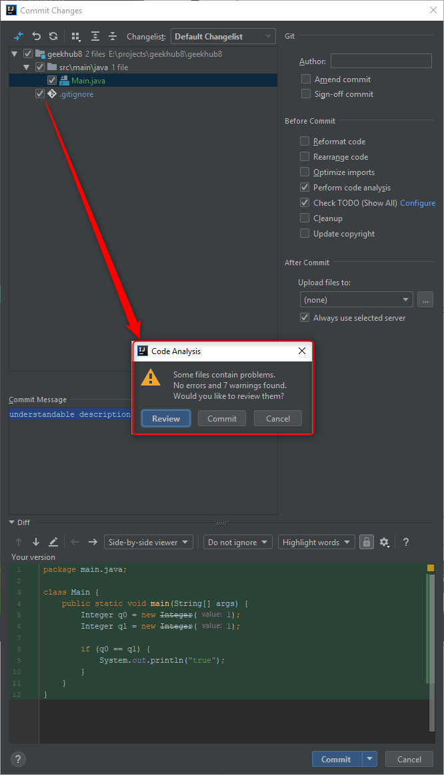
First Commit and Push to Git
Do not commit anything if you got some error or warning message

Slide 33
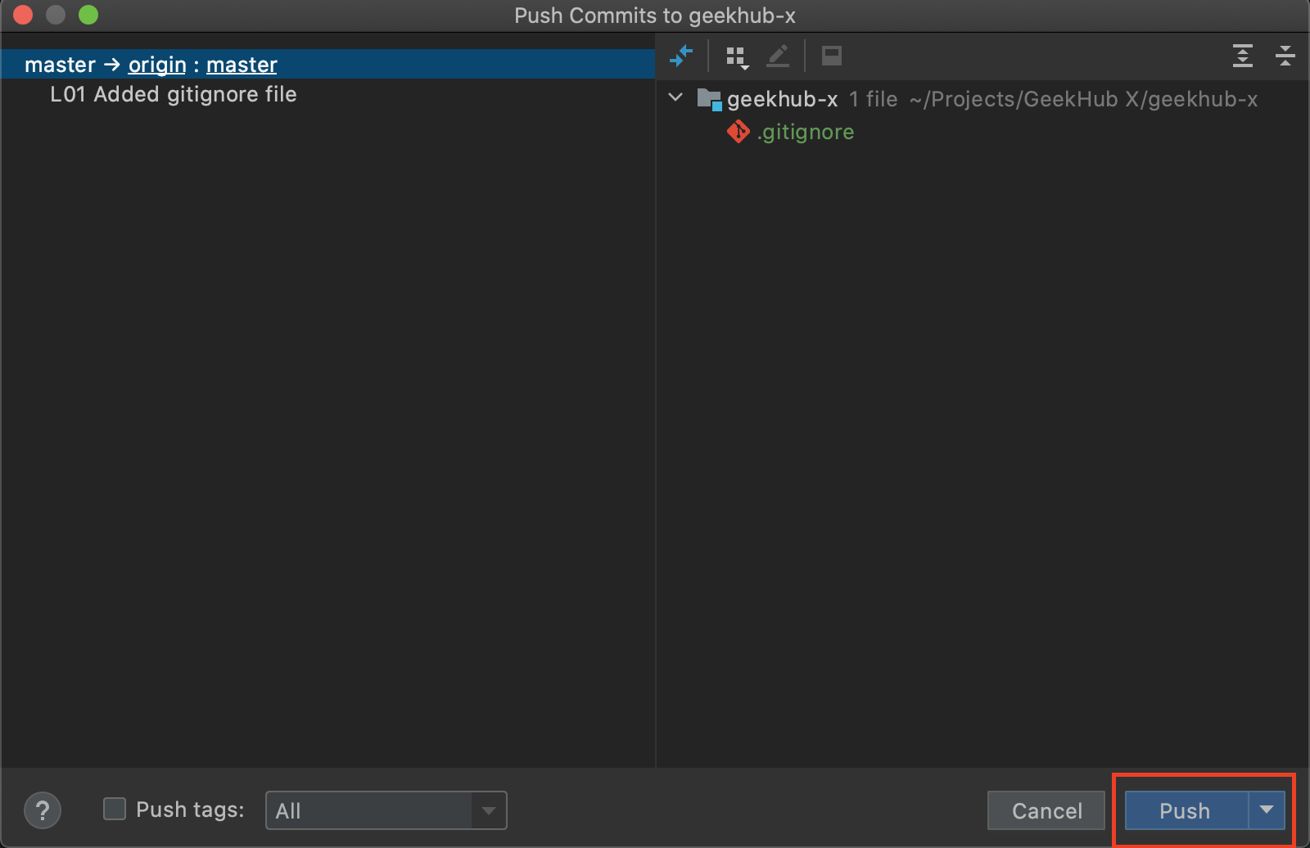
First Commit and Push to Git
Press “Ctrl+Shift+K” to push changes to remote repository
Click “Push”

Slide 34
Homework result

Slide 35
(optional) Take a Screenshot of your project with completed homework
Screenshot must contain
Name of your project on your computer
Committed ”.gitignore” file
Configured “GeekHub Checks” Checkstyle rules

Slide 36
GitLab issue

Slide 37
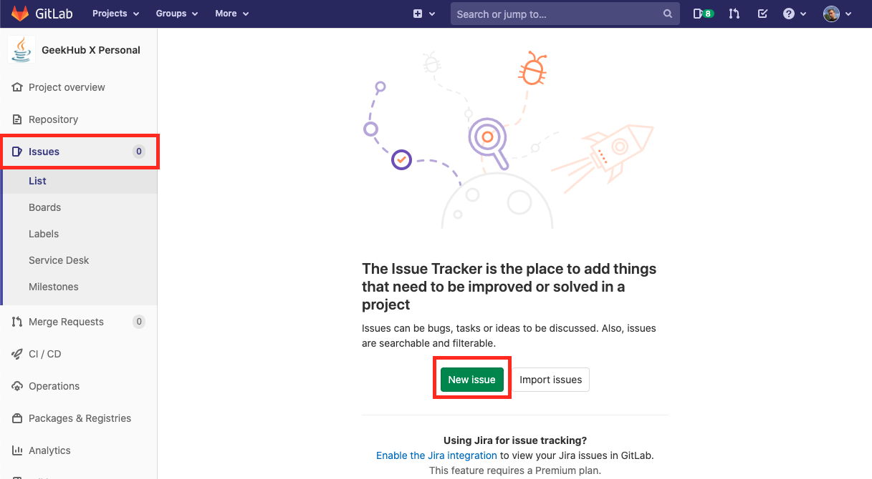
Create issue

Slide 38
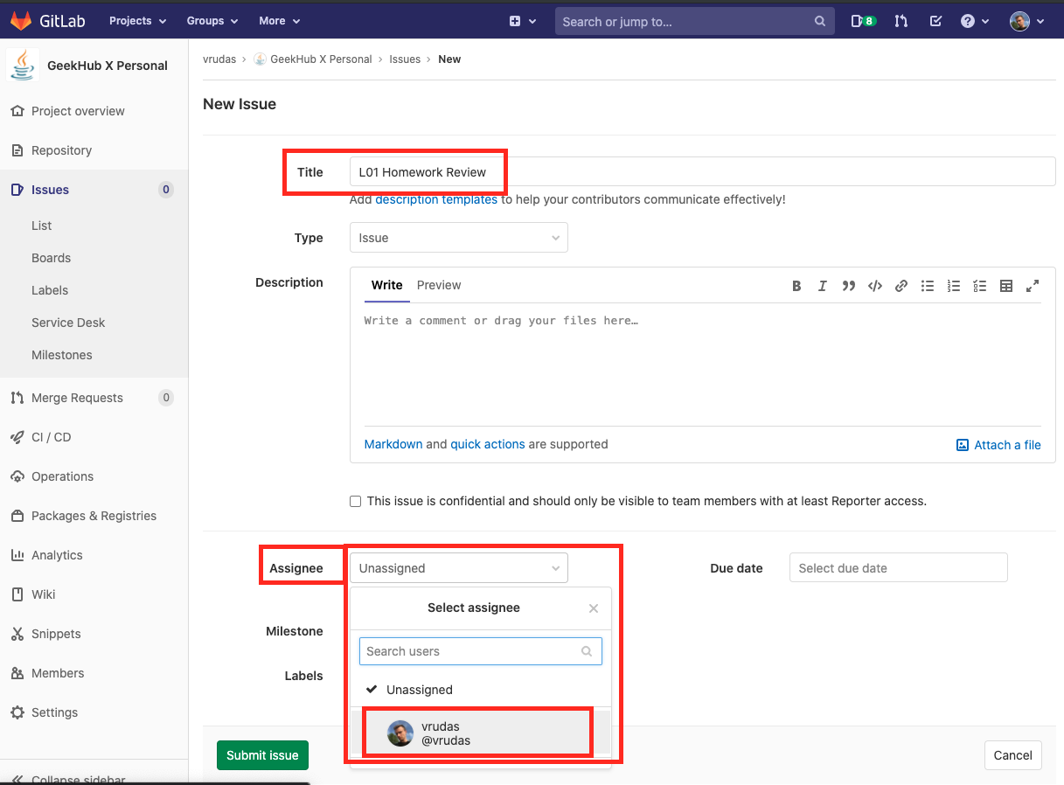
Create issue
Title: L## Homework Review
Assignee: Lector that was on lection

Slide 39
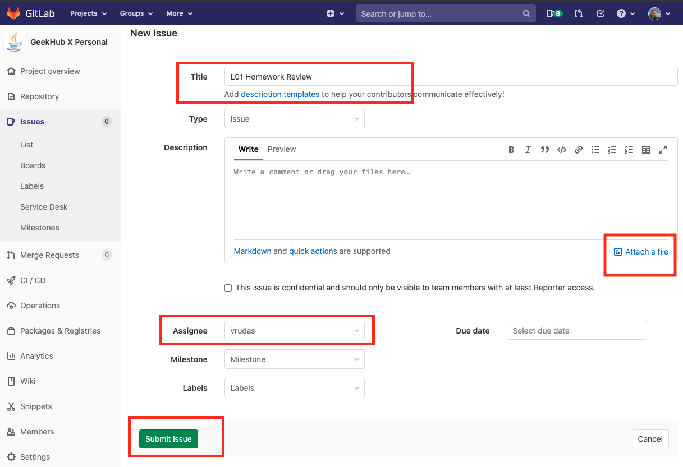
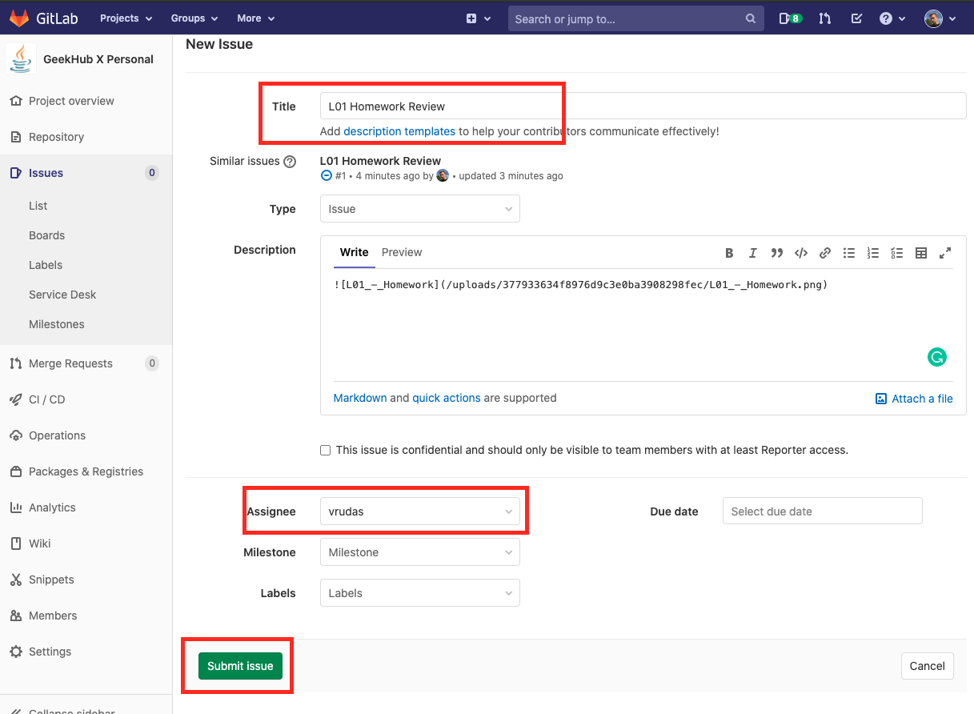
(optional) Attach Homework screenshot

Slide 40
Suubmit issue
Check all required fields and submit issue

Slide 41
Literature
https://git-scm.com/book/en/v2
https://try.github.io
https://gitlab.com/help

